Slide 1



AI Master Class series – Day 10
Overview on CNN | Designing Neural Network

Slide 2
Day-10 Agenda.
01.
02.
03.
Neural Network
Deep Learning Algorithm
CNN & CNN Architecture
04.
05.
Implementation of NN
Designing Neural Network
Neural Network & Perceptron
Overview & Types
Architecture with Softmax Activation Function
Implementation & Basic Syntax on Keras
Pima Indians diabetes classification

Slide 3
Neural Network.
Hidden
Input
Output
It has Interconnected input and output In which each connection has an associated weights
It will adjust the weight during the learning process
Input
Perceptron.
Output
Only Input and output Layer no hidden layer
Simple decision making

Slide 4
Deep Learning Algorithm.
01
ARTIFICIAL NEURAL NETWORK (ANN)
02
RECURRENT NEURAL NETWORK (RNN)
01
CONVOLUTIONAL NEURAL NETWORK (CNN)
www.pantechsolutions.net

Slide 5
ANN.
Hidden
Input
Learns any Non-Linear Function, It is known as Universal Function Approximators
Activation Function introduce non linear property to network, so it will identify complex relationship between input & output
Output of each neuron is the activation of weighted sum of Input, If there is no Activation function, network can't learn non-linear function
Feed Forward Neural Network – Input processed in one direction
When hidden layer is more than one, that is Deep Neural Network
Output

Slide 6
RNN.
Hidden
Input
Looping system in hidden layer of ANN is known as RNN
It captures sequential info of input data, that is dependency between words to make prediction. Whereas, ANN cannot capture sequential information
RNN shares parameters across different time steps, so that there will be few parameter to train
It is the time series version of ANN. Common Recurrent layers are LSTM(Long Short Term Memory) & GRU (Grated Recurrent Units)
GRU is used to how much pass data needed to flow through model
It is mostly used in NLP (Natural Language Processing)
Output

Slide 7
CNN.
CNN learns the filter automatically to extract the right features from the data
It captures spatial features (Arrangement of pixels) whereas ANN can’t.
It also follows parameter sharing like RNN, applies single filter in different part of single image. Whereas ANN can’t.
It don’t have recurrent connections like RNN, instead it has convolution type of hidden layers
Convolution and pooling functions are used as activation functions
CONVOLUTION: Input image and other as Filter on input image(Kernel) produces output image.
POOLING: picking maximum value from selected region is Max pooling and vice versa.

Slide 8
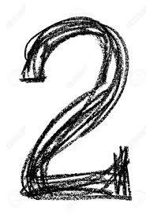
CNN Architecture.
FC_4
Fully Connected
Neural Network
FC_3
Fully Connected
ReLU Activation
Max-pooling
(2x2)
0
Conv_2
Convolution
(5x5)
Max-pooling
(2x2)
1
Conv_1
Convolution
(5x5)
2
.
.
.
.
9
Output
Input
28x28x1
n1 channels
(24 x 24 x n1)
n1 channels
(12 x 12 x n1)
n2 channels
(8 x 8 x n2)
Flattened
n2 channels
(4 x 4 x n2)
n3 units

Slide 9


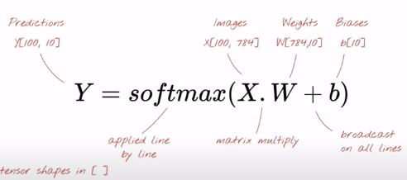
Simple Softmax Classification.

Slide 10
Simple Softmax Classification.
784 Pixels
….
.
.
.
.
Input
28x28x1
.
.
.
.
0
1
2
3
9

Slide 11
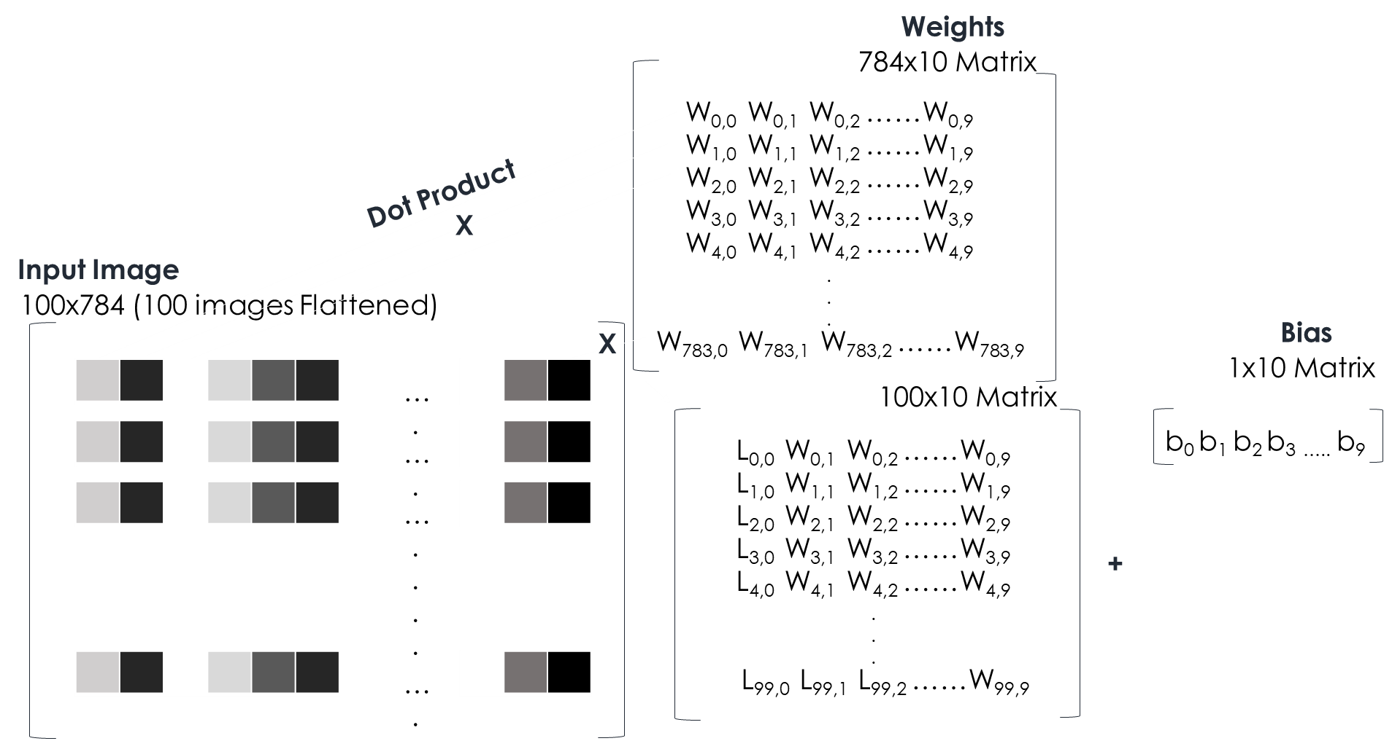
100 image at a time.

Slide 12
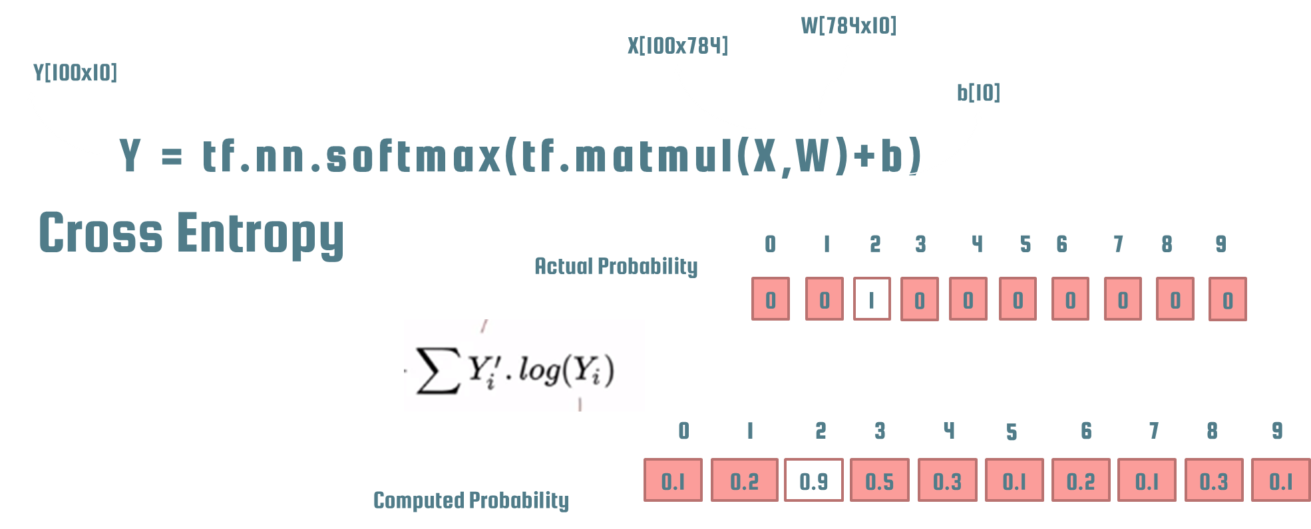
In TensorFlow.

Slide 13
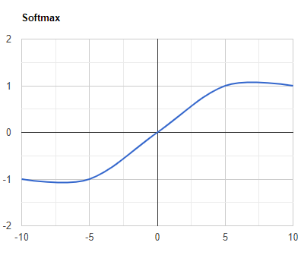
SOFTMAX Function.
Softmax activation function will be applied in the last layer of Neural network, instead of ReLU, tanh, Sigmoid.
It is used to map the non-normalized output of a network to a probability distribution over predicted output class. That is it converts output of last layer into a essential probability distribution.

Slide 14
Implementation of NN.
Feed Forward
Set of Input features and random weights
Weights will be optimized by back propagation
Back Propagation.
Calculating error between predicted output and target output and use Gradient descent method to update weights
Gradient Descent.
Machine Learning algorithm
It operates iteratively to find the optimal values for its parameters. user-defined learning rate, and initial parameter values

Slide 15
Vanishing & Exploding Gradient.
It is very common problem in every Neural Network, which is associated with Backpropagation.
Weights of network are updated through backpropagation by finding gradients.
When the number of hidden layer is high, then the gradient vanishes or explodes as it propagates backward. It leads instability in network, unable to learn from training
The explosion occurs through exponential growth by repeatedly multiplying gradients through the network layers that have values larger than 1.0
It can be fixed by redesigning the network, using Long Short Term Memory networks, Gradient clipping, etc.

Slide 16
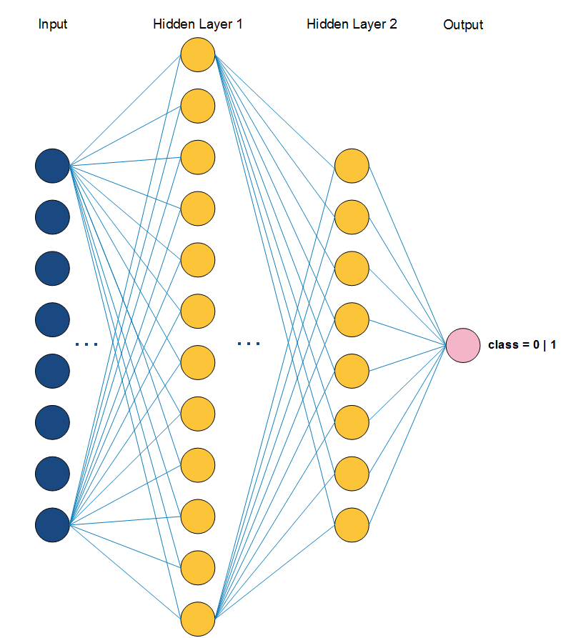
Keras Basic Syntax.
Adding Layers
model.add(Dense(12, input_dim=8, init='uniform', activation='relu'))
model.add(Dense(8, activation='relu'))
Compile Model
model.compile(loss='binary_crossentropy',
optimizer='adam', metrics=['accuracy'])
Optimizer - String identifier of an existing optimizer
loss function - This is the objective that the model will try to minimize
list of metrics - For any classification problem you will want to set this to metrics=['accuracy']

Slide 17
Batch vs Epoch.
Training occurs over epochs and each epoch is split into batches.
Epoch - One pass through all of the rows in the training dataset
Batch - One or more samples considered by the model within an epoch before weights are updated.
Keras Basic Syntax.
Save & Load Model.
Save
Load
model_json = model.to_json()
with open("model.json", "w") as json_file:
json_file.write(model_json)
model.save_weights("model.h5")
print("Saved model to disk")
json_file = open('model.json', 'r')
loaded_model_json = json_file.read()
json_file.close()
loaded_model = model_from_json(loaded_model_json)
loaded_model.load_weights("model.h5")

Slide 18

Practical session
Designing your First Neural Network

Slide 19
Training

Slide 20
from numpy import loadtxt
from keras.models import Sequential
from keras.layers import Dense
from keras.models import model_from_json
dataset = loadtxt('pima-indians-diabetes.csv', delimiter=',')
X = dataset[:,0:8]
y = dataset[:,8]
model = Sequential()
model.add(Dense(12, input_dim=8, activation='relu'))
model.add(Dense(8, activation='relu'))
model.add(Dense(1, activation='sigmoid'))
model.compile(loss='binary_crossentropy', optimizer='adam', metrics=['accuracy'])
model.fit(X, y, epochs=5, batch_size=10)
_, accuracy = model.evaluate(X, y)
print('Accuracy: %.2f' % (accuracy*100))
model_json = model.to_json()
with open("model.json", "w") as json_file:
json_file.write(model_json)
model.save_weights("model.h5")
print("Saved model to disk")

Slide 21
Testing

Slide 22
from numpy import loadtxt
from keras.models import model_from_json
dataset = loadtxt('pima-indians-diabetes.csv', delimiter=',')
X = dataset[:,0:8]
y = dataset[:,8]
json_file = open('model.json', 'r')
loaded_model_json = json_file.read()
json_file.close()
model = model_from_json(loaded_model_json)
model.load_weights("model.h5")
print("Loaded model from disk")
predictions = model.predict_classes(X)
for i in range(5,10):
print('%s => %d (expected %d)' % (X[i].tolist(), predictions[i], y[i]))

Slide 23

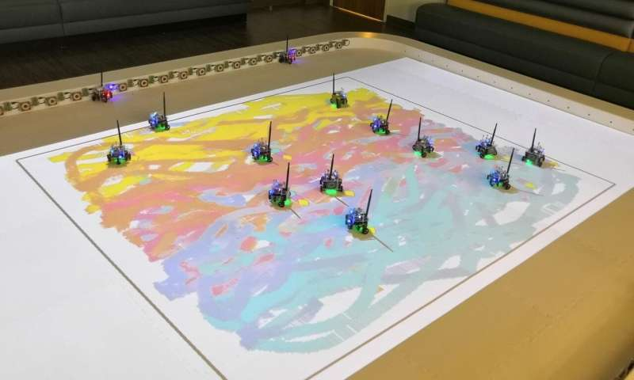
AI News – Day 10. Oct - 2020
swarm of robots to paint a picture
The concept may sound far-fetched, but a recent study in open-access journal Frontiers in Robotics and AI has shown that it is possible
The robots in question move about a canvas leaving color trails in their wake, and in a first for robot-created art, an artist can select areas of the canvas to be painted a certain color and the robot team will oblige in real time.
The technique illustrates the potential of robotics in creating art, and could be an interesting tool for artists.

Slide 24

Thanks!
Tomorrow session
Do you have any questions?
sanjay@pantechmail.com
www.pantechsolutions.net
Object recognition

